Slide 1
Arrowhead Perimeter

Slide 2


Arrowhead Perimeter
Find the perimeter of the arrowhead quadrilateral.
All lines are tangents to the circle.
$$9$$
$$5$$

Slide 3


Arrowhead Perimeter
Find the perimeter of the arrowhead quadrilateral.
All lines are tangents to the circle.
$$9$$
$$a$$
$$a$$
$$5$$

Slide 4

Arrowhead Perimeter
Find the perimeter of the arrowhead quadrilateral.
All lines are tangents to the circle.
$$9$$
$$a$$
$$a$$
$$5+a$$
$$5$$

Slide 5




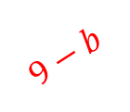
Arrowhead Perimeter
Find the perimeter of the arrowhead quadrilateral.
All lines are tangents to the circle.
$$b$$
$$b$$
$$9$$
$$9−b$$
$$a$$
$$9−b−a$$
$$a$$
$$5+a$$
$$5$$
Summing the perimeter segments:
$$9+\left(9−b−a\right)+5+\left(5+a\right)+b=28$$

Slide 6
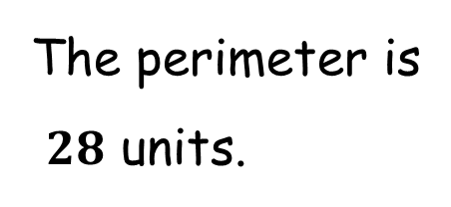
Arrowhead Perimeter
Find the perimeter of the arrowhead quadrilateral.
All lines are tangents to the circle.
$$9$$
The perimeter is
$28$ units.
$$5$$

Slide 7
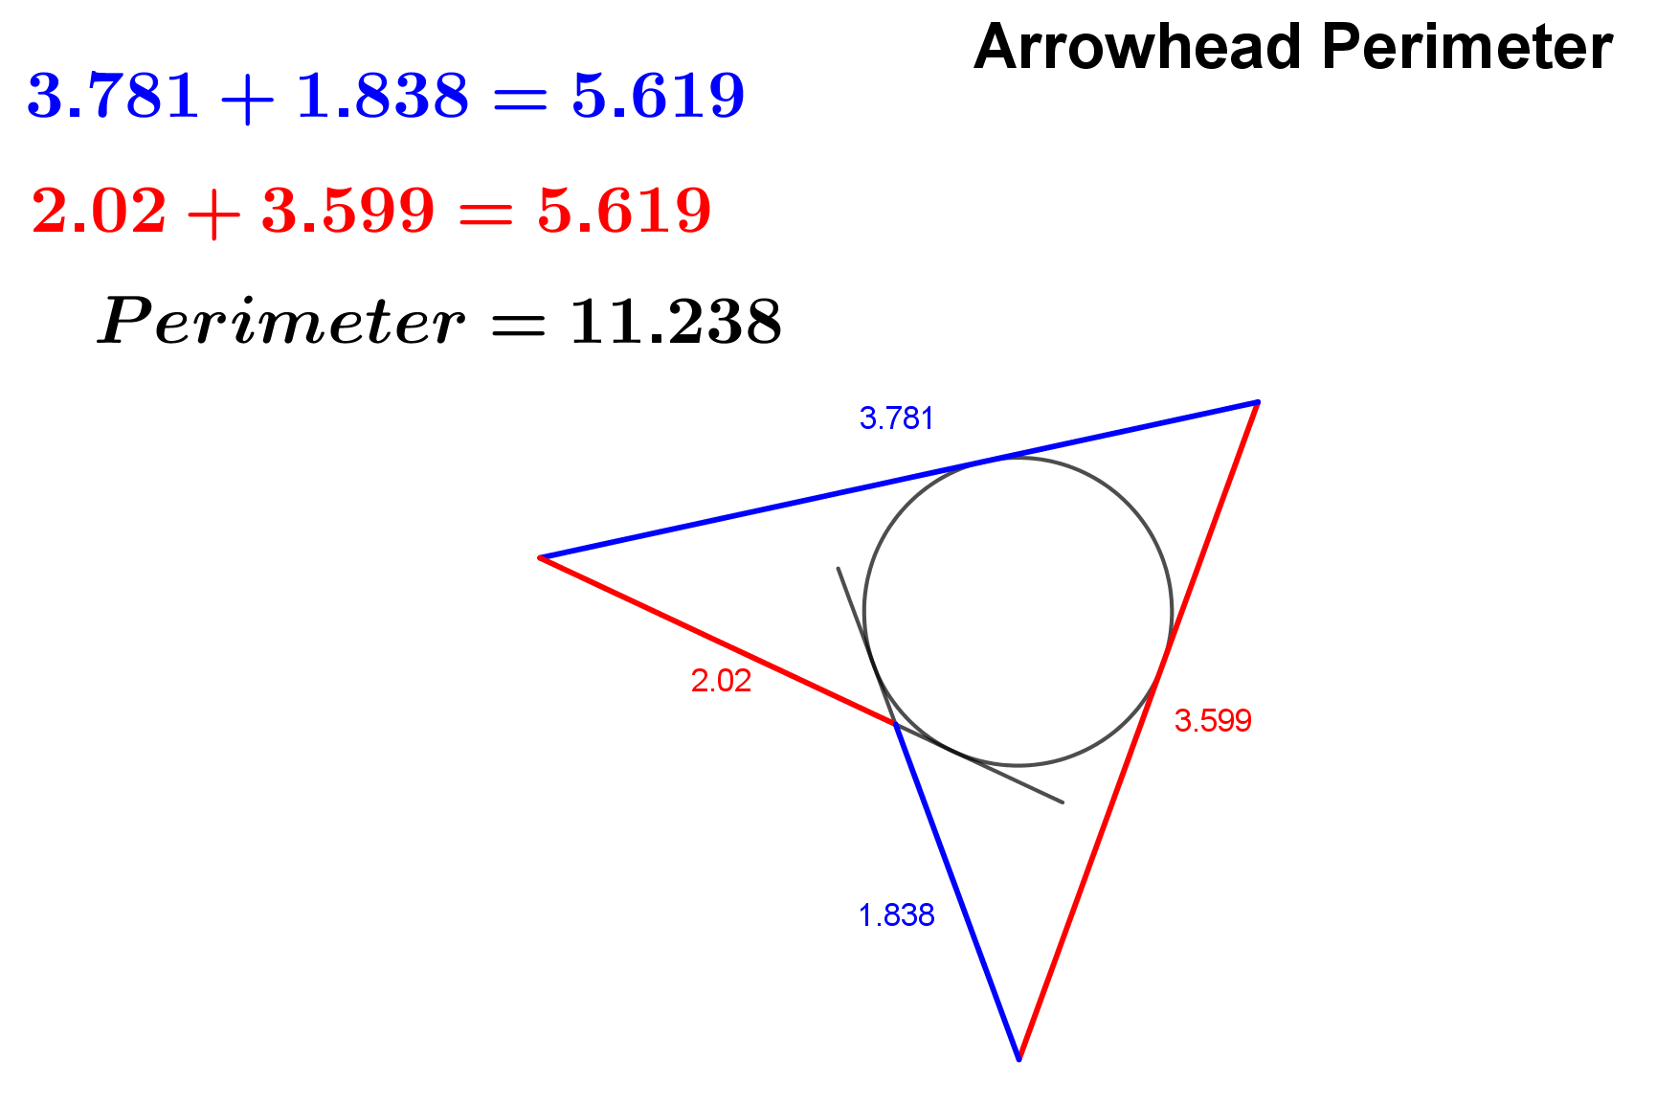

Slide 8
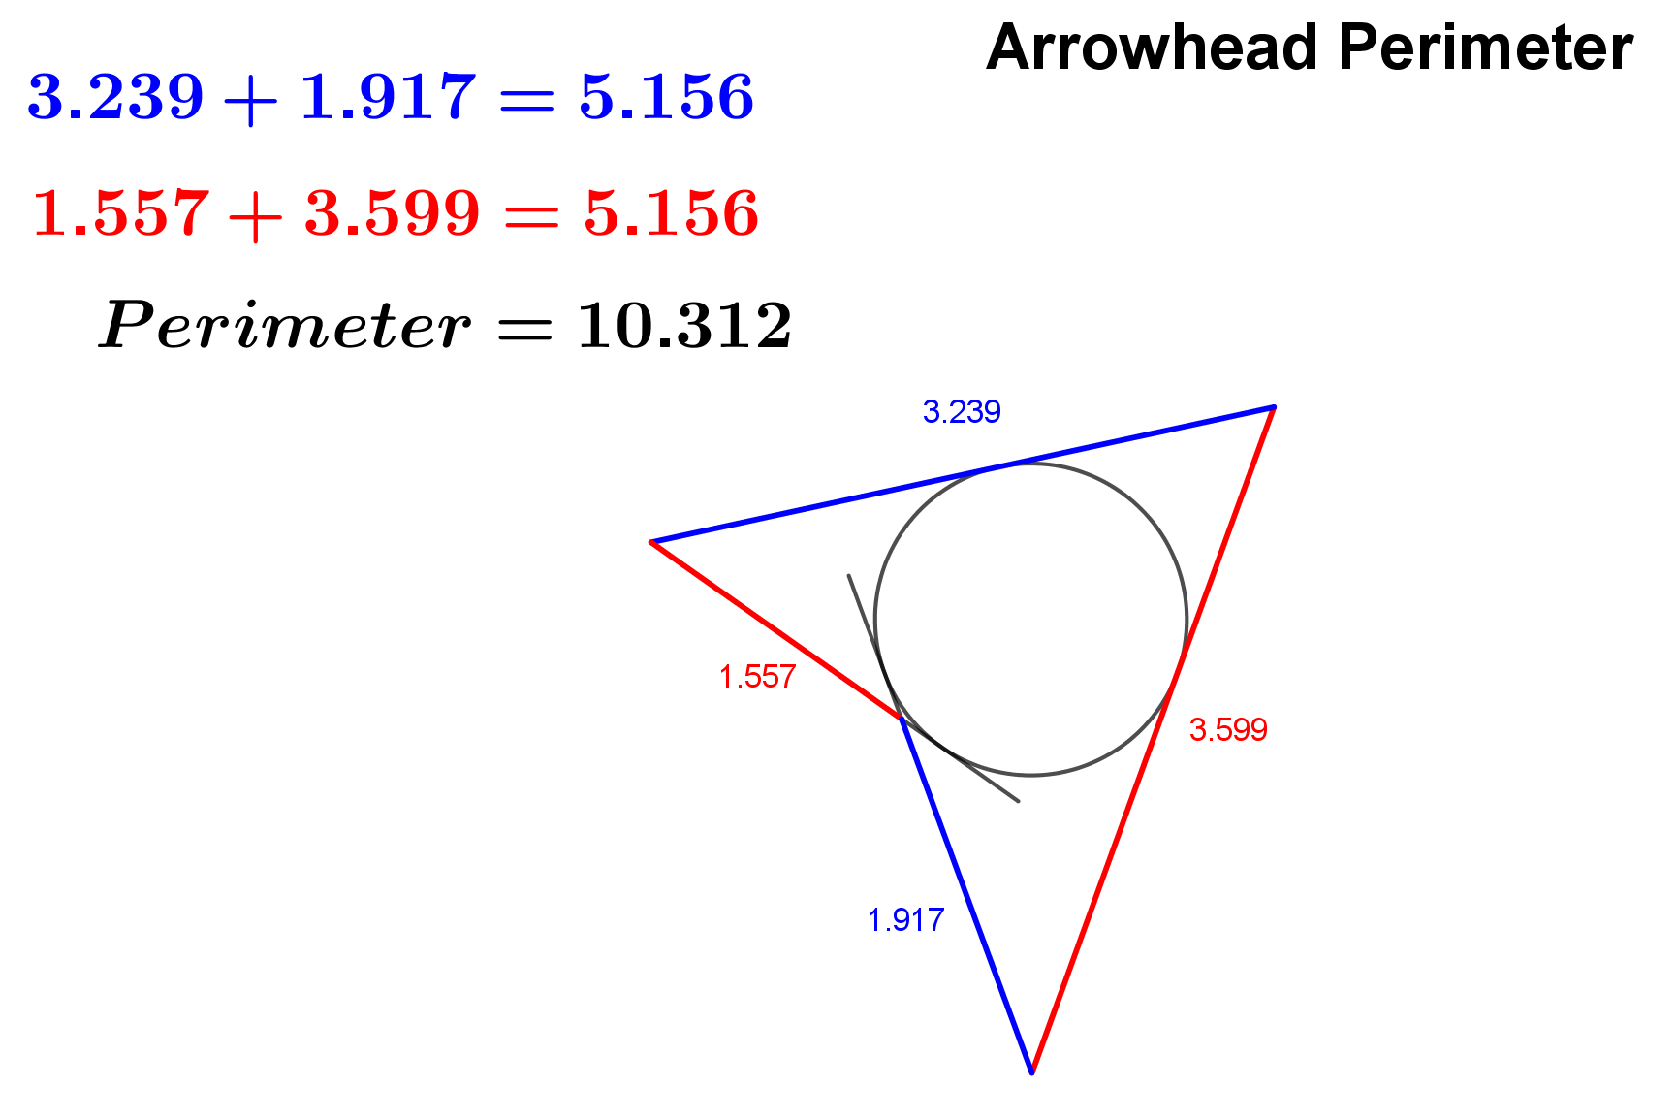

Slide 9
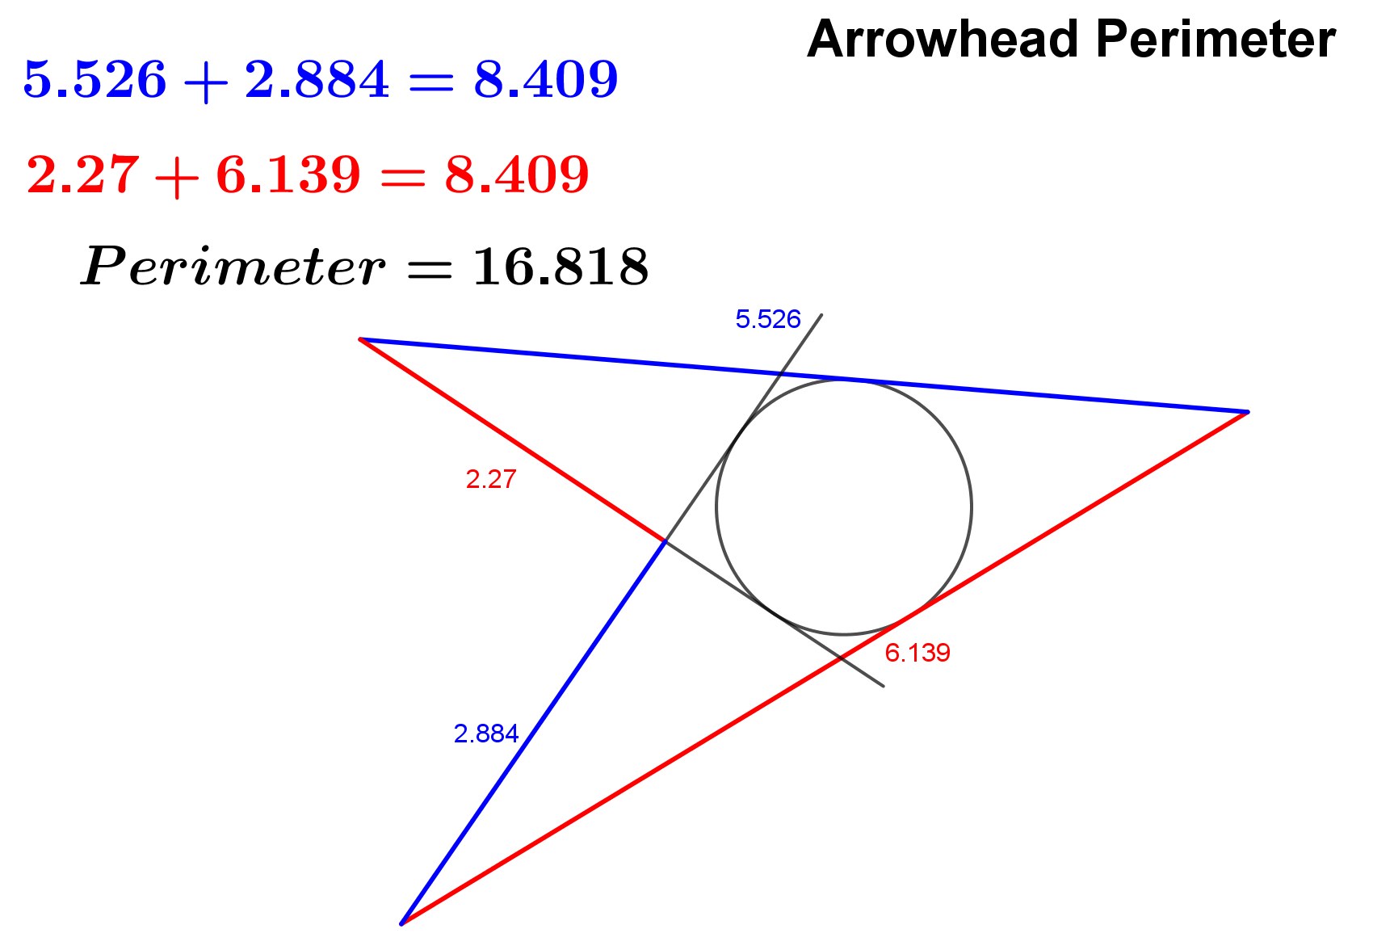

Slide 11
NOTE TO TEACHER
The answer is double the sum of the two given lengths.
For this reason, all the answers are different.
Students need to know (or be told) that external tangents from a point to a circle are equal. Even if they didn’t know, they should be able to handle it.
If you are uncomfortable with using Geogebra, some pictures of the Geogebra app are shown at the end using blue and red segments, illustrating that they are equal in length. This is a consequence of the arrowhead being constructed tangential to the circle.

Slide 12
RESOURCES

Slide 13

Arrowhead Perimeter
SIC_94
Find the perimeter of the arrowhead quadrilateral.
All lines are tangents to the circle.
$$10$$
$$5$$
(not drawn to scale)

Slide 14

Arrowhead Perimeter
SIC_94
Find the perimeter of the arrowhead quadrilateral.
All lines are tangents to the circle.
$$10$$
$$6$$
(not drawn to scale)

Slide 15

Arrowhead Perimeter
SIC_94
Find the perimeter of the arrowhead quadrilateral.
All lines are tangents to the circle.
$$11$$
$$5$$
(not drawn to scale)

Slide 16
Arrowhead Perimeter
SIC_94
Find the perimeter of the arrowhead quadrilateral.
All lines are tangents to the circle.
$$11$$
$$6$$
(not drawn to scale)

Slide 17

Arrowhead Perimeter
SIC_94
Find the perimeter of the arrowhead quadrilateral.
All lines are tangents to the circle.
$$12$$
$$5$$
(not drawn to scale)

Slide 18

Arrowhead Perimeter
SIC_94
Find the perimeter of the arrowhead quadrilateral.
All lines are tangents to the circle.
$$12$$
$$6$$
(not drawn to scale)

Slide 19

Arrowhead Perimeter
SIC_94
Find the perimeter of the arrowhead quadrilateral.
All lines are tangents to the circle.
$$13$$
$$5$$
(not drawn to scale)

Slide 20
Arrowhead Perimeter
SIC_94
Find the perimeter of the arrowhead quadrilateral.
All lines are tangents to the circle.
$$13$$
$$6$$
(not drawn to scale)

Slide 21

Arrowhead Perimeter
SIC_94
Find the perimeter of the arrowhead quadrilateral.
All lines are tangents to the circle.
$$12$$
$$4$$
(not drawn to scale)

Slide 22

Arrowhead Perimeter
SIC_94
Find the perimeter of the arrowhead quadrilateral.
All lines are tangents to the circle.
$$12$$
$$3$$
(not drawn to scale)

Slide 23
Arrowhead Perimeter
SIC_94
Find the perimeter of the arrowhead quadrilateral.
All lines are tangents to the circle.
$$13$$
$$4$$
(not drawn to scale)

Slide 24
Arrowhead Perimeter
SIC_94
Find the perimeter of the arrowhead quadrilateral.
All lines are tangents to the circle.
$$13$$
$$3$$
(not drawn to scale)

Slide 25

Arrowhead Perimeter
SIC_94
Find the perimeter of the arrowhead quadrilateral.
All lines are tangents to the circle.
$$8$$
$$3$$
(not drawn to scale)

Slide 26

Arrowhead Perimeter
SIC_94
Find the perimeter of the arrowhead quadrilateral.
All lines are tangents to the circle.
$$8$$
$$2$$
(not drawn to scale)

Slide 27

Arrowhead Perimeter
SIC_94
Find the perimeter of the arrowhead quadrilateral.
All lines are tangents to the circle.
$$15$$
$$5$$
(not drawn to scale)

Slide 28

Arrowhead Perimeter
SIC_94
Find the perimeter of the arrowhead quadrilateral.
All lines are tangents to the circle.
$$15$$
$$6$$
(not drawn to scale)

Slide 29

Arrowhead Perimeter
SIC_94
Find the perimeter of the arrowhead quadrilateral.
All lines are tangents to the circle.
$$16$$
$$5$$
(not drawn to scale)

Slide 30

Arrowhead Perimeter
SIC_94
Find the perimeter of the arrowhead quadrilateral.
All lines are tangents to the circle.
$$16$$
$$6$$
(not drawn to scale)

Slide 31

Arrowhead Perimeter
SIC_94
Find the perimeter of the arrowhead quadrilateral.
All lines are tangents to the circle.
$$17$$
$$5$$
(not drawn to scale)

Slide 32
Arrowhead Perimeter
SIC_94
Find the perimeter of the arrowhead quadrilateral.
All lines are tangents to the circle.
$$17$$
$$6$$
(not drawn to scale)

Slide 33


Arrowhead Perimeter
SIC_94
Find the perimeter of the arrowhead quadrilateral.
All lines are tangents to the circle.
$$20$$
$$8$$
(not drawn to scale)

Slide 34


Arrowhead Perimeter
SIC_94
Find the perimeter of the arrowhead quadrilateral.
All lines are tangents to the circle.
$$20$$
$$7$$
(not drawn to scale)

Slide 35

Arrowhead Perimeter
SIC_94
Find the perimeter of the arrowhead quadrilateral.
All lines are tangents to the circle.
$$22$$
$$7$$
(not drawn to scale)

Slide 36

Arrowhead Perimeter
SIC_94
Find the perimeter of the arrowhead quadrilateral.
All lines are tangents to the circle.
$$23$$
$$8$$
(not drawn to scale)

